Slide 1
C H A P T E R 7
Data Structures
Abstractions of the actual data organization in main memory
Allow users to perceive data as ‘logical units’ (e.g.: arrangement in rows and columns)

Slide 2
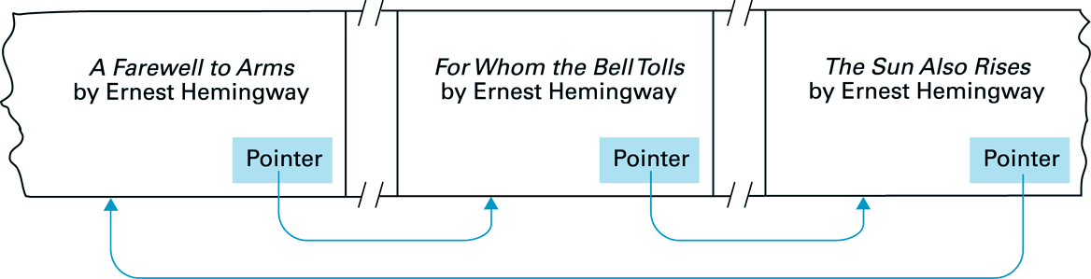
7.1: Data Structure Basics: Pointers
Pointers:
pointer = location in memory that contains the address of another location in memory
so: pointer points to data positioned elsewhere in memory
64B0
F02A
FF8C
F02A
FF8C
64B0

Slide 3
7.1: Static versus Dynamic Data Structures
Static:
shape & size of structure does not change over time
example in C: int Table[2][9];
Table:
Dynamic:
shape & size may change
example: Stack
32
65
Stack:
97
48
17

Slide 4
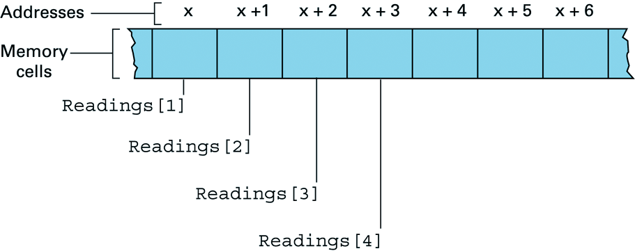
7.2: Arrays
Example: to store 24 hourly temperature readings…
… a convenient storage structure is 1-D homogeneous array of 24 elements (e.g. in C: float Readings[24] )
In main memory:
… x + 23
Address of Readings[i] = x + (i-1)

Slide 5
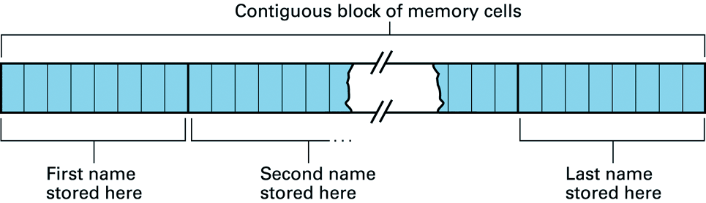
7.3: Lists
To store an ordered list of names we could use 2-D homogeneous array (in C: char Names[10][8])
However:
addition & removal of names requires expensive data movements!

Slide 6
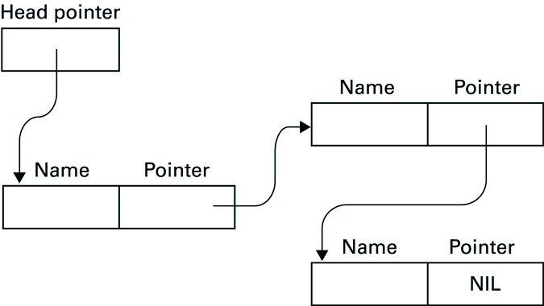
7.3: Linked Lists
Data movements can be avoided by using a ‘linked list’, including pointers to list entries

Slide 7
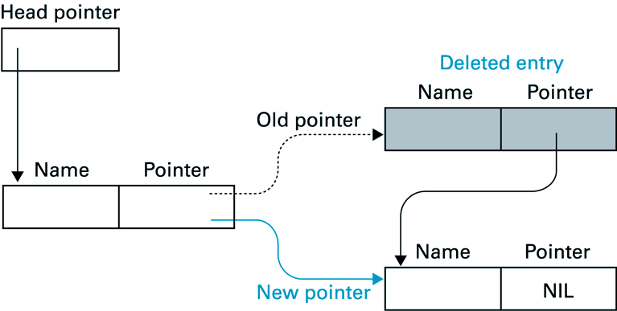
7.3: Deleting an Entry from a Linked List
A list entry is removed by changing a single pointer:

Slide 8
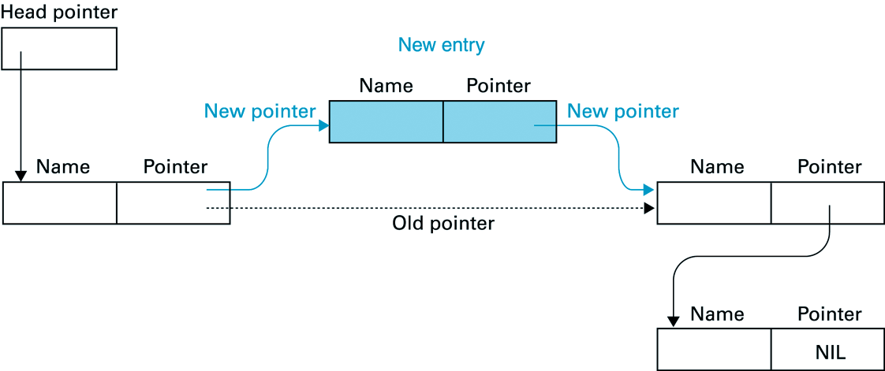
7.3: Inserting an Entry into a Linked List
A new entry is inserted by setting pointer of
(1) new entry to address of entry that is to follow
(2) preceding entry to address of new entry:

Slide 9
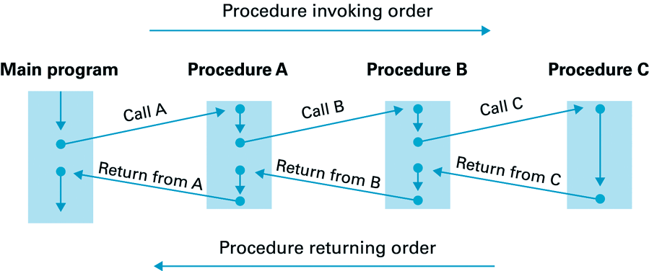
7.4: Stacks
Disadvantage of contiguous array structures:
insertion / removal requires costly data movements
Still okay if insertion / removal restricted to end of array => stack (with push & pop operations)
Typical use:

Slide 10
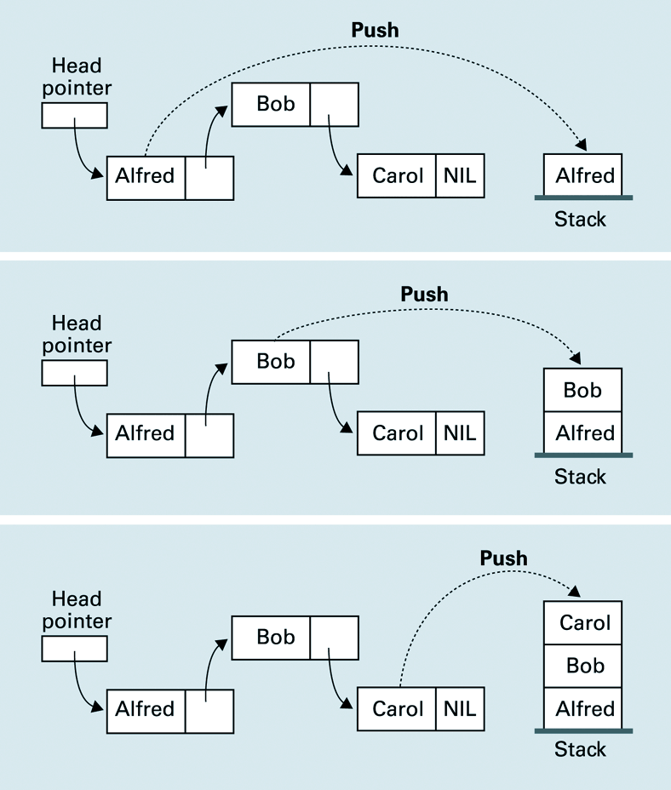
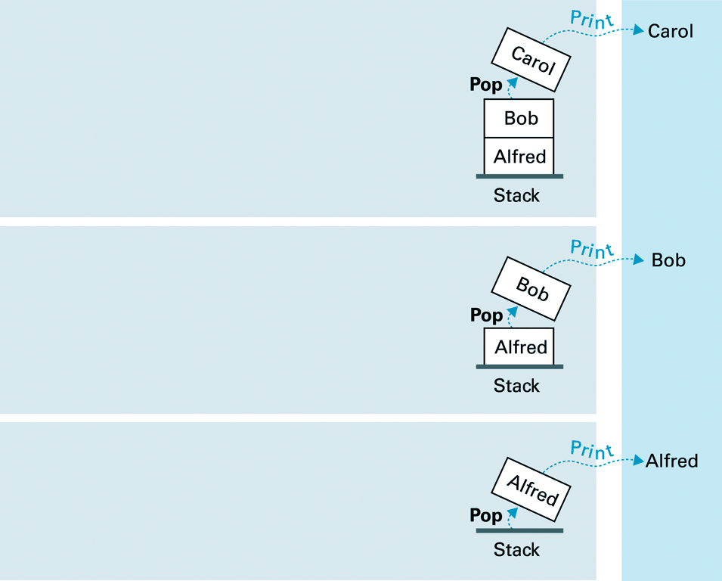
7.4: Push / Pop (to print inverse linked list)

Slide 11
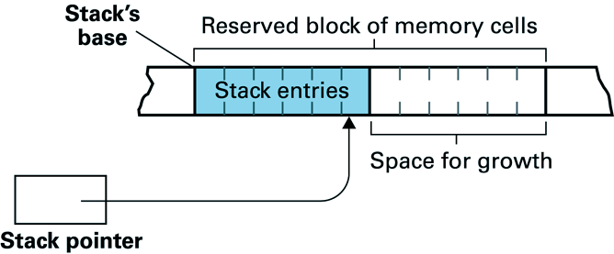
7.4: A Stack in Memory
Here:
conceptual structure close to identical to actual structure in memory
If maximum stack-size unknown:
pointers can be used ( => conceptual = actual structure )

Slide 12
Chapter 7 - Data Structures: Conclusions
Pointers:
basic aid in definition of dynamic data structures
Often used data structures:
Arrays
Lists
Stacks
…

Slide 13
C H A P T E R 8
File Structures
Reference: Computer Science an Overview
Author: J. Glenn Brook Shear
6th Edition
Abstractions of the actual data organization on mass storage
Again: differences between conceptual and actual data organization

Slide 14
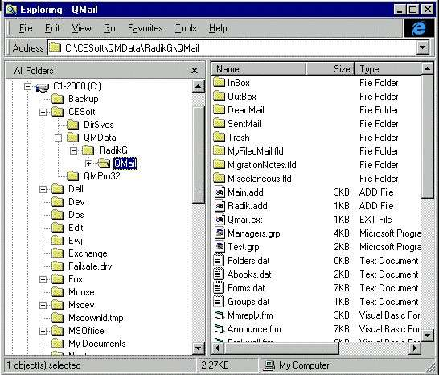
8.1: Files, Directories & the Operating System
OS storage structure:
conceptual hierarchy of directories and files
directory tree
files

Slide 15
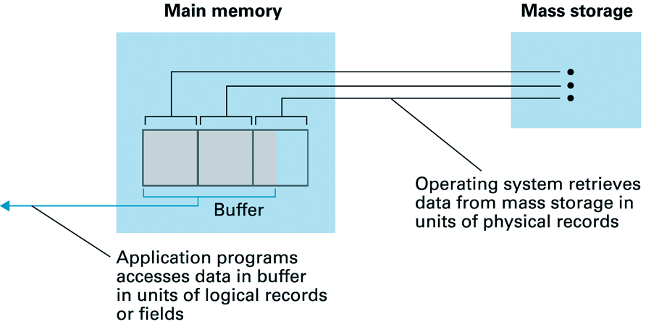
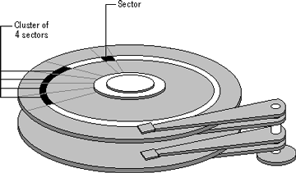
8.1: Files: Conceptual vs. Actual View
View at OS-level is conceptual
actual storage may differ significantly!

Slide 16
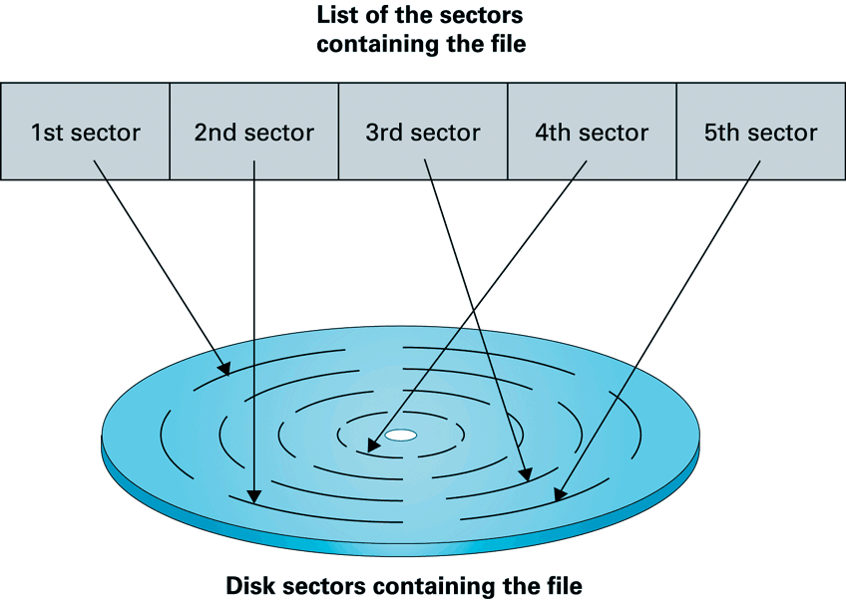
8.2: Sequential Files
To ‘remember’ where data resides on disk, the OS maintains a list of sectors for each file
Result: sequential view of scattered set of data

Slide 17
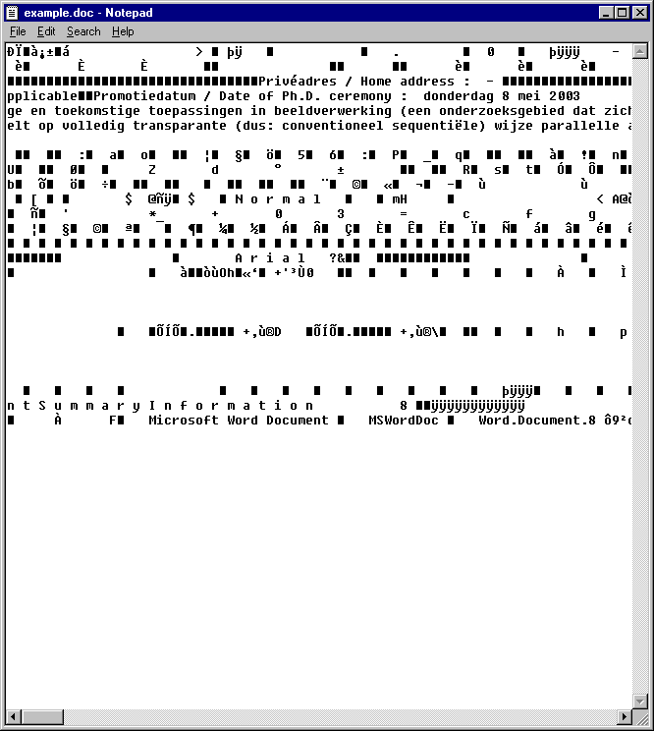
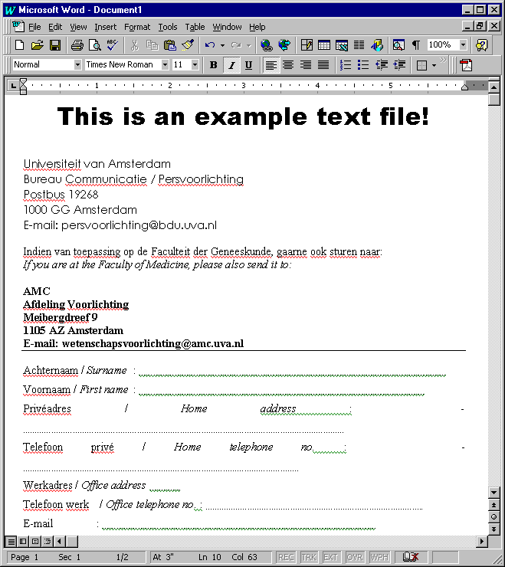
8.2: Text Files
Sequential file consisting of long string of encoded characters (e.g. ASCII-code)
But: character-string still interpreted by word processor!
File in “Notepad”
Same file in “MS Word”

Slide 18
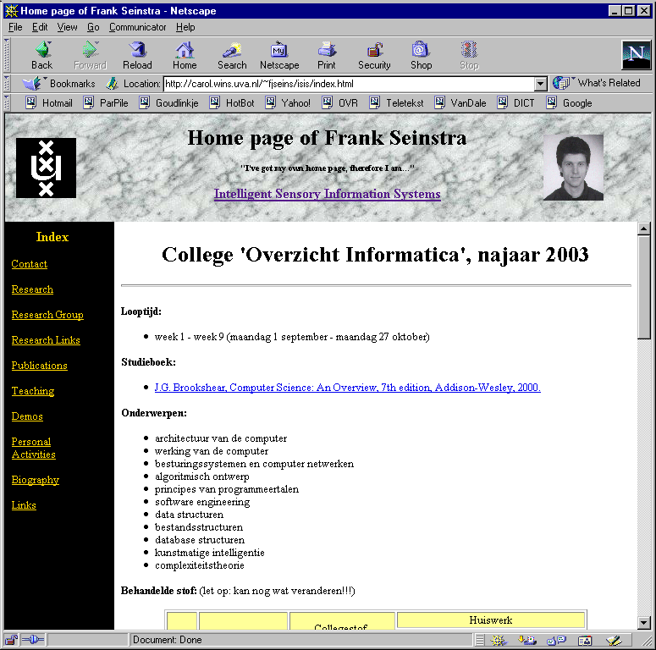
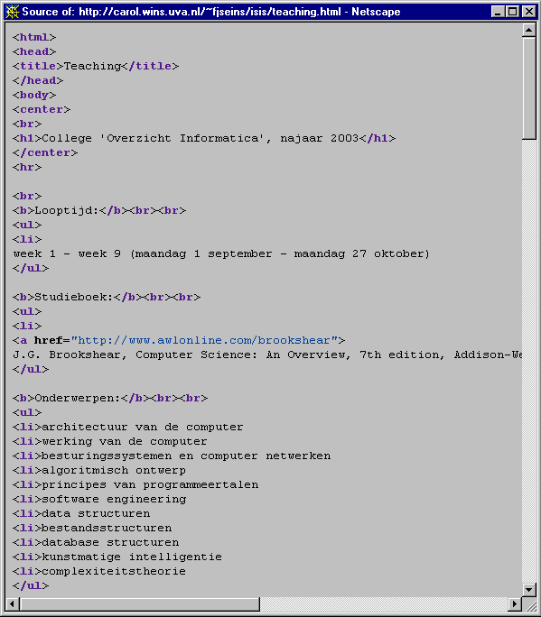
8.2: Text files & Markup Languages (e.g. HTML)

Slide 19
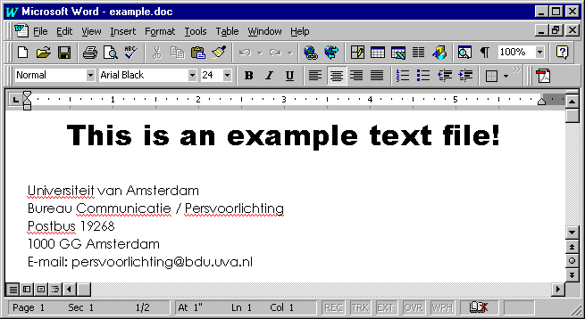
8.2: From actual storage to conceptual view
conceptual view
Interpretation by Application Program
Sequential buffer
sequential view
Assembly by Operating System
actual storage

Slide 20
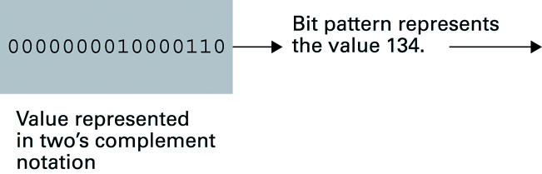
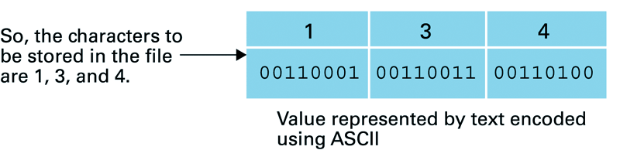
8.2: Data Conversion
When programming: note that data transfer to/from file may involve data conversion:
e.g., from two’s complement notation to ASCII:
So: again it’s about the interpretation of data

Slide 21
8.3: Quick File Access
Disadvantage of sequential files:
no quick access to particular file data
Two techniques to overcome this problem:
(1) Indexing or (2) Hashing
loaded into main
memory when opened
Indexing:
Indexed File
Index
keys

Slide 22
Chapter 8 - Problem 10 Why is a ‘patient identification number’ a better choice for a key field than the last name of each patient?
If key unique:
additional sequential search never required
Patient’s last name is not always unique

Slide 23
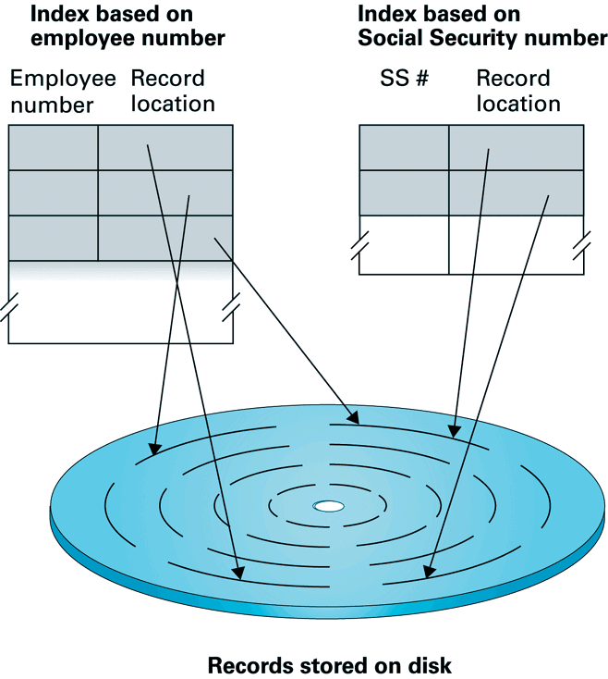
8.3: Inverted Files
Variation to (single) indexing: inverted file

Slide 24

8.4: Hashing
Disadvantage of indexing is… the index
requires extra space
Solution: ‘hashing’
finds position in file using a key value (as in indexing)…
… simply by identifying location directly from the key
How?
define set of ‘buckets’ & ‘hash function’ that converts keys to bucket numbers
key value
hash function
bucket number
…
0 1 2 3 … N

Slide 25
Chapter 8 - File Structures: Conclusions
File Structures:
abstractions of actual data organization on mass storage
Changes of ‘view’:
actual storage -> sequential view by OS -> conceptual view presented to user
Quick access to particular file data by
(1) indexing (many forms)
(2) hashing (requires no index, but requires bucket search!)

